Slide 1
Speaking session 3
Workplace communication

Slide 2
PRONUNCIATION EXERCISE
ENNEAGRAM
“Enneagram is a 9-Point Personality Type and Self Development tool that is widely used and favoured by psychologists and researchers, and it is very useful in helping people in:
1. Achieving personal growth
2. Cultivating effective relationships at work, home and social
Supporting your strengths, identifying your blind spots and managing expectations
….”
Source: https://www.team-raeda.com/enneagram

Slide 3
REFLECT ON A VIDEO

Slide 4
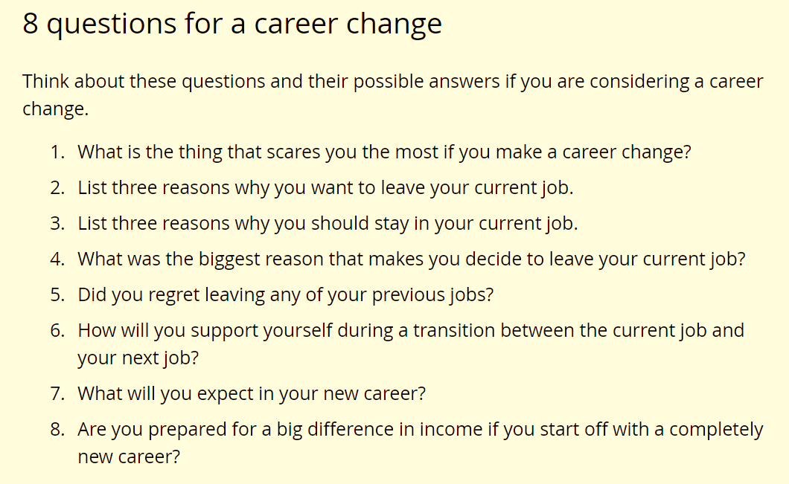
ANSWERING SHORT QUESTIONS

Slide 5
Topic for discussion
Is micromanagement* healthy? Why or why not?
*micromanagement: a style of management which controls tightly every detail

Slide 6
Cultivate (v.): to develop, to nurture
On-the-job (OTJ) training / proFESsional training
Micro-management # macro-management
PersoNAlity
psychologist
reSEARcher -> to research (v)
→ research (n) → a research on human relationships

Slide 7
Intonation: you raise your voice in the middle of the long sentences to signify the listeners that the sentence has not finished.
You lower your voice at the end of the sentences.

